Slide 1


Introduction to GPGPU Programming
Junqi Yin
National Institute for Computational Sciences
June 9, 2015

Slide 2
Pnmath
Outline:
Motivation
History
GPU architecture
GPU programming model
CUDA C
CUDA tools
Other useful GPU tools
Summary
References
Notes:
Here is outline of today’s talk. I will talk about following topics.

Slide 3
Pnmath
Motivation (GPU):
High CPU load
  Physics, AI, network
Graphic demand
  Fast memory access
    Many lookups [ vertices, normal, textures, … ]
  High bandwidth usage
    A few GB/s needed in regular cases !
  Large number of flops
    Flops = Floating Point Operations [ ADD, MUL, SUB, … ]
    Illustration: matrix-vector products
      (16 MUL + 12 ADD) x (#vertices + #normals) x fps =
      (28 Flops) x (6.000.000) x 30 ≈ 5GFlops
Conclusion: Real time graphics needs supporting hardware!
Notes:
First let’s talk about why did we need GPU at all ? Then we will talk about how GPU can be useful for scientific computing.

Slide 4
Pnmath
History:
GPU: Graphics Processing Unit
  Designed to rapidly manipulate and alter memory in such a way so as to accelerate the building of images in a frame buffer intended for output to a display.
  The term was popularized by NVIDIA in 1999.
Notes:
GeForce 256 as "the world's first 'GPU', or Graphics Processing Unit, a single-chip processor with integrated transform, lighting, triangle setup/clipping, and rendering engines that is capable of processing a minimum of 10 million polygons per second".
ATI Technologies coined the term visual processing unit or VPU with the release of the Radeon 9700 in 2002.

Slide 5
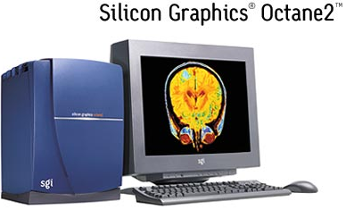
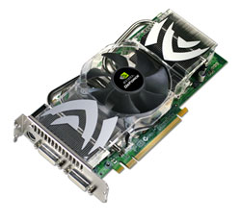
Pnmath
History of Graphics Hardware:
…-mid ’ 90s
  SGI mainframes and workstations
  PC: only 2D graphics hardware
mid’ 90s
  Consumer 3D graphics hardware (PC)
    3dfx, NVIDIA, Matrox, ATI, …
  Triangles rasterization (only)
1999
  PC-card with TnL (Transform and Lighting) … ]
    NVIDIA GeForce: Graphics Processing Unit (GPU)
  PC-card more powerful than specialized workstations
Modern graphics hardware
  Graphics pipeline partly programmable
  Leaders: NVIDIA and AMD
  Game consoles similar to GPUs(Xbox, Wii and Playstation)
Notes:
What is Triangles rasterization ??
Wha it TnL (Transform and Lighting) ?

Slide 6

Pnmath
What is GPGPU:
General Purpose computation using GPU
in applications other than 3D graphics
  GPU accelerates critical path of application
Data parallel algorithms leverage GPU attributes
  Large data arrays, streaming throughput
  Fine-grain SIMD parallelism
  Low-latency floating point (FP) computation
Applications – see //GPGPU.org
  Game effects (FX) physics, image processing
  Physical modeling, computational engineering, matrix algebra, convolution, correlation, sorting

Slide 7
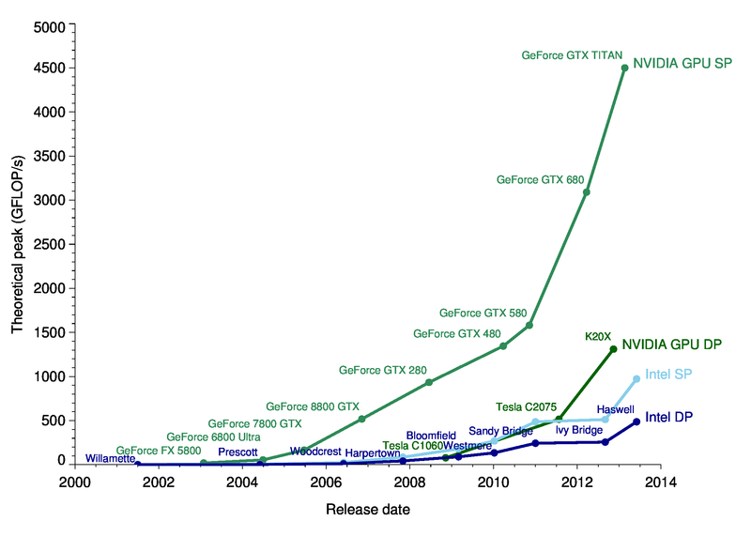
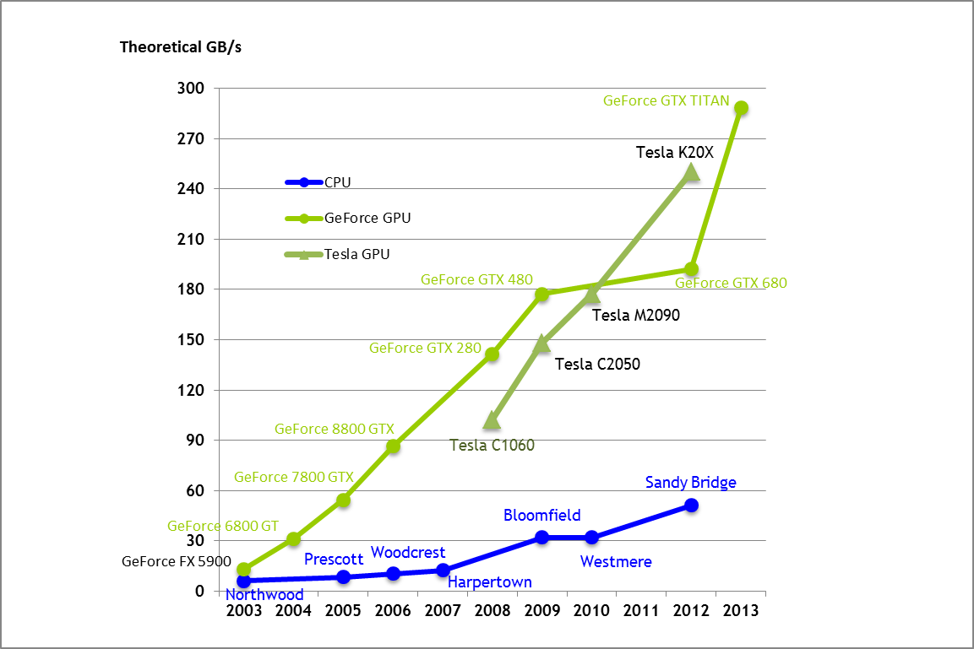
Pnmath
Motivation (GPGPU):
Computation
Memory

Slide 8
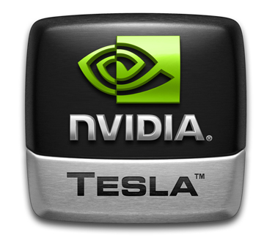
Pnmath
GPU continue:
Modern GPUs are very efficient at
  Manipulating computer graphics, and their highly parallel structure makes them more effective than general-purpose CPUs for algorithms where processing of large block of data is done in parallel.
GPUs are massively multithreaded manycore chips.
  NVIDIA tesla products have upto 512 cores.
  Over 665 GFLOPS sustained performance (double precision floating point)
  6GB of Memory
  Memory bandwidth upto 177 GBytes/sec.
Users across science and engineering disciplines are achieving very good speedups on GPUs.
Notes:
Tesla M2090
Peak Double precision 665 Gigaflops (Tesla M2090)
Peak Single precision 1331 Gigaflops (Tesla M2090)
Memory bandwidth ➔ 177 GBytes/sec (internal)
Memory size => 6GB
512 CUDA cores
Users across science & engineering disciplines are achieving 100x or better speedups on GPUs

Slide 9
Pnmath
NVIDIA GPUs:
Desktop GPUs
  GeForce series for CPU
Mobile GPUs
  GeForce series for Mobile
Workstation GPUs
  Quadro NVS, Tesla

Slide 10
Pnmath
NVIDIA GPUs:
Supports CUDA and OpenCL
Fermi(Tesla version)
  Upto 512 cores
  Upto 6GB memory
  Upto 665 GFLOPS – Double precision
  Caches included: L1 per multiprocessor, L2 shared
Kepler in 2012
Maxwell in 2014

Slide 11
Pnmath
AMD GPUs:
Desktop GPUs
  Radeon series
Mobile GPUs
  Mobility Radeon
Workstation GPUs
  FirePro, FireStream
Supports OpenCL (no CUDA)

Slide 12
Pnmath
Typical Supercomputer:
Large amount of nodes.
  Distributed memory
  Multicore processors (e.g. 12 cores per node Kraken)
Fast interconnect.
Programming models
  MPI
  Hybrid (Pthreads/OpenMP with MPI)

Slide 13
Pnmath
Accelerated Supercomputer:
Accelerated HPC floating workloads using GPUs.
  Peak FP performance 10x vs CPU.
  Memory bandwidth 20x vs CPU.
  Parallelism, of the order of 500 cores, thousands of threads.
GPUs are accelerators.
  Has its own fast memory.
  Separate card connected to CPU node Via PCI-E bus.
Notes:
Peripheral Component Interconnect Express: PCI Express is used in consumer, server, and industrial applications, as a motherboard-level interconnect (to link motherboard-mounted peripherals), a passive backplane interconnect and as an expansion card interface for add-in boards.

Slide 14
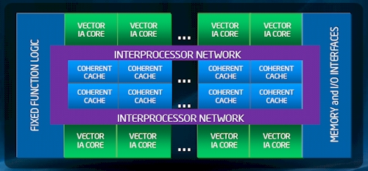
Pnmath
Other accelerators:
Intel
  Intel MIC(Many Integrated Core)
  ~ 63 X86 vector cores
  OpenMP, OpenCL, Intel parallel building blocks etc...
  First commercial product(Knights corner) in 2012.
Other(FPGA and DSP based system etc…)
Reference: http://intel.com

Slide 15
Pnmath
*Not* for all applications:
SIMD(Single Program, Multiple Data) are best.
Operations need to be sufficient size to overcome overhead of memory transfer.
Think millions of operations.

Slide 16
Pnmath
How it is different from CPU:
GPU is specialized for compute-intensive, highly parallel computation-exactly what graphics rendering is about.
GPU devotes more transistors to data processing rather than data caching and flow control.
Notes:
The reason behind the discrepancy in floating-point capability between the CPU and the GPU is that the GPU is specialized for compute-intensive, highly parallel computation – exactly what graphics rendering is about – and therefore designed such that more transistors are devoted to data processing rather than data caching and flow control, as schematically illustrated by Figure 1-2.
I will talk about Memory Hierchcy in detail .

Slide 17
Pnmath
More on GPU:
The GPU is viewed as a compute device that.
  Is a coprocessor to the CPU or host
  Has its own device memory
  Runs many threads in parallel
Data-parallel portions of an application are executed on the device as kernels which run in parallel on many threads
Differences between GPU and CPU threads
  GPU threads are extremely lightweight (Very little creation overhead)
  GPU needs 1000s of threads for full efficiency(Multi-core CPU needs only a few)

Slide 18
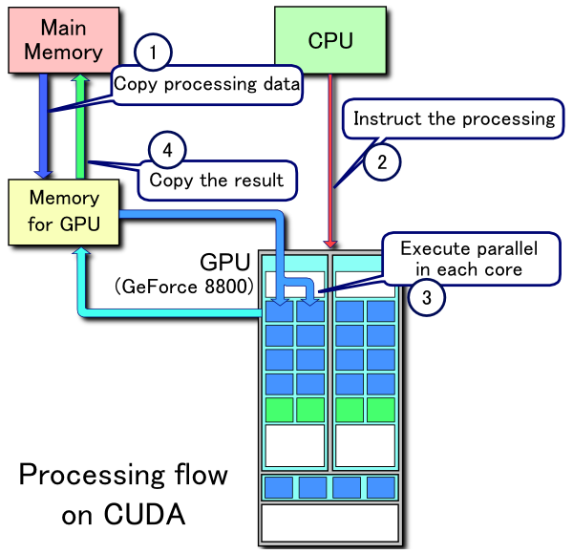
Pnmath
Trying it together:

Slide 19
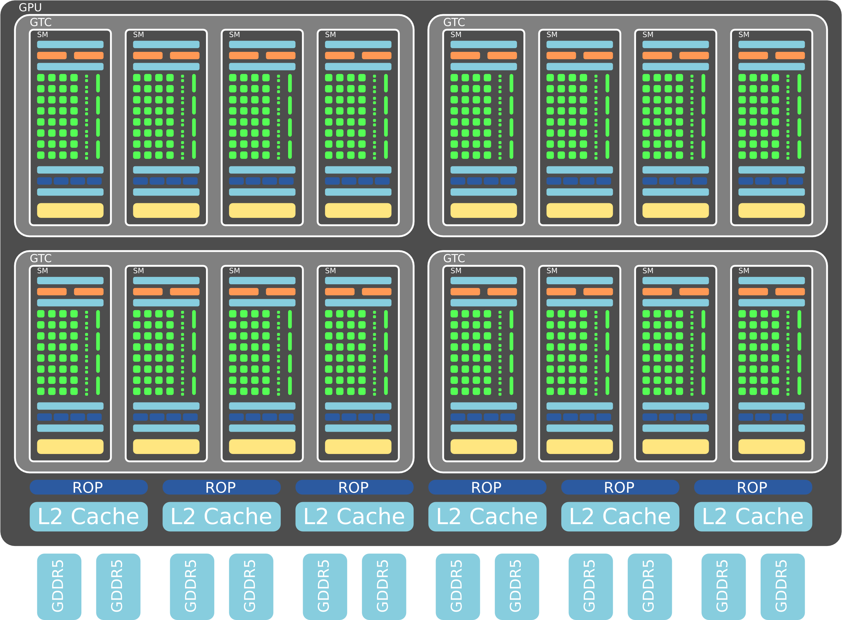
Pnmath
GPU architecture :
Streaming Multiprocessors (SMs)
32 cores
Reference: http://nvidia.com
Notes:
High level block diagram of NVIDIA GPU chip :
NVIDIA’s Fermi GPU architecture consists of multiple streaming multiprocessors (SMs), each consisting of 32 cores, each of which can execute one floating point or integer instruction per clock.
The SMs are supported by a second-level cache, hostinterface, GigaThread scheduler, and multiple DRAM interfaces.
The 512 CUDA cores are organized in 16 SMs of 32 cores each.
A Raster Opterator - basically, they're the final stage of pushing pixels to your screen. Larger numbers of these are fairly unimportant compared to other pipelines, since they spend a lot of their time idle waiting for pixels to push.
Raster Operation Unit

Slide 20
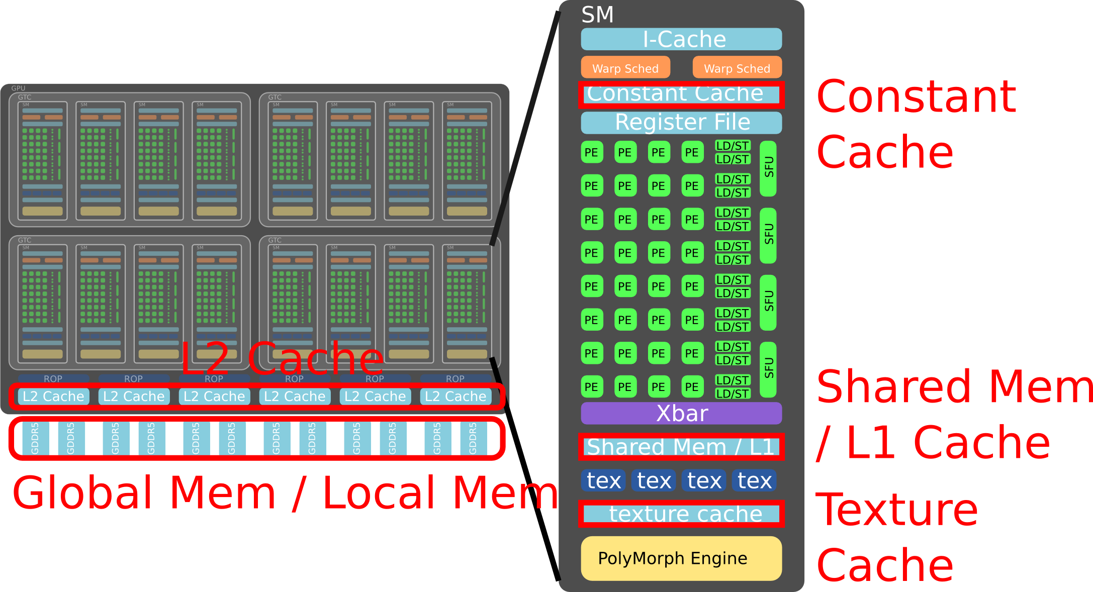
Pnmath
GPU architecture :
Multilevel levels of memory hierarchy
Reference: http://nvidia.com
Notes:
If we zoom in one of the SM it looks like this.
Where PE=processing elements
ROP = Raster operators.

Slide 21
Pnmath
Terminology:
Thread: is a ready for execution/running instance of a kernel. Each thread has its own instruction address counter and register state.
Warp: is a group of 32 parallel threads.
Block: is a groups of Warps. A block is executed on one multiprocessor. Every block has its own shared memory and registers in the multiprocessor.
Grid: is a group of Blocks.
Host: is the CPU in CUDA applications.
Device: is the GPU in CUDA applications.
Notes:
Thread: is a ready-for-execution/running instance of a kernel. Each thread has its own instruction address counter and register state. Each thread can be identified by a combination of its three-dimensional thread index and three-dimensional thread-block index. CUDA threads are lightweight. This means that creating and destroying a thread is very fast.
Warp: is a group of 32 parallel threads. The multiprocessors create and execute warps in order. All threads in a warp start together but each of them can have its own instruction and registers.
Block: is a group of Warps. A block is executed on one multiprocessor. Every block has its own shared memory and registers in the multiprocessor.
Grid: is a group of blocks. There should be at least as many blocks as multiprocessors (and preferably at least 2× as many).
Host: is the CPU in CUDA applications.
Device: is the GPU in CUDA applications.

Slide 22
Pnmath
A set of SIMD multiprocessors:
A device has a set of multiprocessors
Each multiprocessors is a set of 32-bit processors with Single Instruction Multiple Data architecture.
At each clock cycle, a multiprocessor executes the same instruction on a group of threads called warp.
The number of threads in a warp is the warp size.
Device
Multiprocessor N
Multiprocessor 2
Multiprocessor 1
Instruction
Unit
Processor 1
Processor 2
…
Processor M
Reference: http://nvidia.com
Notes:
Register per thread (faster than local memory)
Local memory : per thread
Shared memory : per block (all threads in block can access it)
Global memory : shared with all blocks + accessible by host not cached
Constant memory : shared with all block + accessible by host cached (There is a total of 64 KB constant memory on a device.) Read only by threads. Host can write it.
Texture memory : shared with all block + accessible by host cached. Read only by threads. Host can write it.

Slide 23
Pnmath
Hardware Execution Model:
SIMD Execution of warpsize=M threads (from single block)
  Result is a set of instructions streams roughly equal to # of blocks in threads divided by warpsize.
Multithreaded Execution across different instruction streams within block.
  Also possibly across different blocks if there are more blocks than SMs(streaming multiprocessors)
Each block mapped to single SM
  No direct interaction across SMs
Device
Multiprocessor N
Multiprocessor 2
Multiprocessor 1
Shared Memory
Registers
Registers
Registers
Instruction
Unit
Processor 1
Processor 2
…
Processor M
Constant
Cache
Texture
Cache
Device memory
Reference: http://nvidia.com
Notes:
Register per thread (faster than local memory)
Local memory : per thread
Shared memory : per block (all threads in block can access it)
Global memory : shared with all blocks + accessible by host not cached
Constant memory : shared with all block + accessible by host cached (There is a total of 64 KB constant memory on a device.) Read only by threads. Host can write it.
Texture memory : shared with all block + accessible by host cached. Read only by threads. Host can write it.

Slide 24
Pnmath
Memory Model:
GPU has much more aggressive memory subsystem
The local, global, constant and texture spaces are regions of device memory.
Each multiprocessor has:
  A set of 32-bit registers per processors
  On chip shared memory
  A read-only constant cache (To speed up access to the constant memory space)
  A read-only texture cache
  (To speed up access to the texture memory space)
Device
Multiprocessor N
Multiprocessor 2
Multiprocessor 1
Shared Memory
Registers
Registers
Registers
Instruction
Unit
Processor 1
Processor 2
…
Processor M
Constant
Cache
Texture
Cache
Device memory
Global, constant, texture memories
Reference: http://nvidia.com
Notes:
Register per thread (faster than local memory)
Local memory : per thread
Shared memory : per block (all threads in block can access it)
Global memory : shared with all blocks + accessible by host not cached
Constant memory : shared with all block + accessible by host cached (There is a total of 64 KB constant memory on a device.) Read only by threads. Host can write it.
Texture memory : shared with all block + accessible by host cached. Read only by threads. Host can write it.

Slide 25
Pnmath
GPU memory model:
Each thread can:
  Read/write per-thread registers
  Read/write per-thread local memory
  Read/write per-block shared memory
  Read/write per-grid global memory
  Read only per-grid constant memory
  Read only per-grid texture memory
The host can read/write global/constant, and texture memory
Grid
Block (0, 0)
Block (1, 0)
Shared Memory
Shared Memory
Registers
Registers
Registers
Registers
Thread (0, 0)
Thread (1, 0)
Thread (0, 0)
Thread (1, 0)
Local
Memory
Local
Memory
Local
Memory
Local
Memory
Host
Global
Memory
Constant
Memory
Texture
Memory
Reference: http://nvidia.com
Notes:
Register per thread (faster than local memory)
Local memory : per thread
Shared memory : per block (all threads in block can access it)
Global memory : shared with all blocks + accessible by host not cached
Constant memory : shared with all block + accessible by host cached (There is a total of 64 KB constant memory on a device.) Read only by threads. Host can write it.
Texture memory : shared with all block + accessible by host cached. Read only by threads. Host can write it.

Slide 26
Pnmath
GPU programming:
How to use GPUs
Use existing GPU software
Use available libraries for GPUs
Program GPU with directives
Program native GPU code
Low
EFFORT
High
Notes:
Applications => NWCHEM, GROMACS, HMMER,
E.g. ➔ Numerical libraries (MAGAM, CULA, CUFFT, CUBLAS )
GPU directives => OpenACC, HMPP and OpeMP 4.0
Native code => Using CUDA and OpenCL

Slide 27
Pnmath
Use existing GPU software:
NAMD, GROMACS, GPU-HMMER, TeraChem
Pros
  No implementation headaches for end users.
Cons
  Existing applications do not cover all science areas.
  Often include limited number of algorithms/models.
  For many applications the GPU version is still immature.
Notes:
Existing applications do not cover all science areas
• Often include limited number of algorithms/models
• For many applications the GPU version is still immature

Slide 28
Pnmath
GPU programming model:
GPU accelerator is called device, CPU is host.
GPU code (kernel) is launched and executed on the device by several threads.
Threads grouped into thread blocks.
Program code is written from single thread's point of view.
  Each thread can diverge and execute a unique code path (can cause performance issues )
Notes:
Divergence
– Threads in a warp take different execution paths
Reason: Control Flows in Code
– E.g., if, do, for, while, switch
• Input Data Dependence
– Input data-set --> execution path
– Thread-data mapping --> amount of thread divergence
Effect: It Degradis GPU Throughput

Slide 29
Pnmath
Thread Batching: Grids and Blocks
A kernel is executed as a grid of thread blocks
  All threads share data memory space
A thread block is a batch of threads that can cooperate with each other by:
  Synchronizing their execution
  Efficiently sharing data through a low latency shared memory
Two threads from two different blocks cannot cooperate
Host
Device
Grid 1
Kernel 1
Block
(0, 0)
Block
(1, 0)
Block
(2, 0)
Block
(0, 1)
Block
(1, 1)
Block
(2, 1)
Grid 2
Kernel 2
Block (1, 1)
Thread
(0, 0)
Thread
(1, 0)
Thread
(2, 0)
Thread
(3, 0)
Thread
(4, 0)
Thread
(0, 1)
Thread
(1, 1)
Thread
(2, 1)
Thread
(3, 1)
Thread
(4, 1)
Thread
(0, 2)
Thread
(1, 2)
Thread
(2, 2)
Thread
(3, 2)
Thread
(4, 2)
Reference: http://nvidia.com

Slide 30
Pnmath
Block and Thread IDs
Threads and blocks have IDs
  So each thread can decide what data to work on
  Block ID: 1D or 2D (blockIdx.x, blockIdx.y)
  Thread ID: 1D, 2D, or 3D (threadIdx.{x,y,z})
Simplifies memory
addressing when processing
multidimensional data
  Image processing
  Solving PDEs on volumes
  …
Device
Grid 1
Block
(0, 0)
Block
(1, 0)
Block
(2, 0)
Block
(0, 1)
Block
(1, 1)
Block
(2, 1)
Block (1, 1)
Thread
(0, 0)
Thread
(1, 0)
Thread
(2, 0)
Thread
(3, 0)
Thread
(4, 0)
Thread
(0, 1)
Thread
(1, 1)
Thread
(2, 1)
Thread
(3, 1)
Thread
(4, 1)
Thread
(0, 2)
Thread
(1, 2)
Thread
(2, 2)
Thread
(3, 2)
Thread
(4, 2)
Reference: http://nvidia.com

Slide 31
Pnmath
Thread Hierarchy :
Threads:
  3D IDs, unique in block
Blocks:
  2D IDs, unique in grid
Dimensions are set at kernel launch.
Built-in variables for device code:
  threadIdx, blockIdx
  blockDim, gridDim
Notes:
Built-in variables for device code:
– threadIdx, blockIdx – blockDim,gridDim

Slide 32
Pnmath
Introduction to CUDA:
Compute Unified Device Architecture
CUDA is a C/C++ language extension for GPU programming.
  PGI has developed similar FORTRAN 2003 extension.
Two APIs: Runtime and Driver
Notes:
You have to have Nvidia GPU, Driver and CUDA SDK (Latest is 5.0)

Slide 33
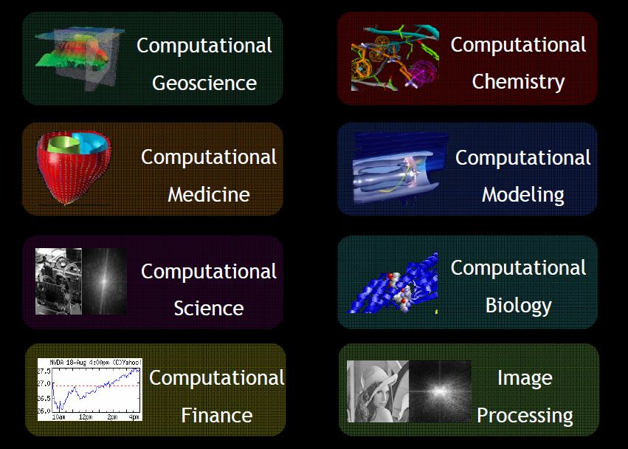
Pnmath
CUDA applications:

Slide 34
Pnmath
CUDA software stack:
Reference: http://nvidia.com
Notes:
CUDA libraries
CUDA Runtime: NVCC and PTX
CUDA Driver
GPU

Slide 35
Pnmath
Introduction to CUDA C:
Qualifiers
  global, device, shared, local, constant…
Built-in variables
  threadIdx, blockIdx
Intrinsics
  __syncthreads,
Runtime API
  Memory, device execution management.
Kernel launch
__device__ float array[128];
__global__ void kern(float *data){
__shared__ float buffer[32};
....
buffer[threadIdx.x] = data[i];
....
__syncthreads;
....
}
float *d_data;
cudaMalloc((void **))&d_data, bytes);
kern<<<1024, 128>>>(d_data);
Notes:
You need to have basic knowledge of C/C++ to learn CUDA.
These are some basic C introduction, Not a complete list by any means.
__device__ float array[128]; __global__ void kern(float *data) { __shared__ float buffer[32]; ... buffer[threadIdx.x] = data[i]; ... __syncthreads; ... }
float *d_data; cudaMalloc((void**)&d_data, bytes); kern<<<1024, 128>>>(d_data);
__syncthreads, => Synchronizes in all thread of current block
Kernels designated by function qualifier:
__device__
Function called from device and run on device Cannot be called from host code
__global__
Function called from host and executed on device Must return void
Other CUDA function qualifiers
__host__
Function called from host and executed on host (default)
__host__ and __device__ qualifiers can be combined to generate both CPU and GPU code

Slide 36
Pnmath
CUDA function declarations:
 | Executed on the: | Only callable from the:
__device__ float DeviceFunc() | device | device
__global__ void KernelFunc() | device | host
__host__ float HostFunc() | host | host

Slide 37
Pnmath
Vector add CPU:
void add(int *a, int *b, int *c)
{
int i;
for (i=0; i<N; i++)
{
c[i] = a[i] + b[i];
}
}

Slide 38
Pnmath
CUDA memory management:
//include header files
#include <cuda.h>
#include <cutil.h>
//include kernels
#Add "vector_add_kernel gpu code here" //next slide
static const int N = 100000;
int main( int argc, char** argv) {
int a[N], b[N], c[N];
int *dev_a, *dev_b, *dev_c;
//Memory allocation on device
cudaMalloc(&dev_a, N*sizeof(int);
cudaMalloc(&dev_b, N*sizeof(int);
cudaMalloc(&dev_c, N*sizeof(int);
//Memory copy host to device
cudaMemcpy(dev_a, a, N*sizeof(int), cudaMemcpuKind:cudaMemcpuHostToDevice);
cudaMemcpy(dev_b, b, N*sizeof(int), cudaMemcpuKind:cudaMemcpuHostToDevice);
//Call Kernel (in next slide)
//Copy result from GPU to CPU
cudaMemcpy(c,dev_c, N*sizeof(int), cudaMemcpuKind:cudaMemcpuDeviceToHost);
//Free memory
cudaFree(dev_a); cudaFree(dev_b); cudaFree(dev_c);
}
gpucode.cu
// Initialize vectors on host
int p;
for( p = 0; p < n; p++ ) {
a[p] = sin(p)*sin(p);
b[p] = cos(p)*cos(p);
}
Notes:
I allocate three Device vectors (dev_a, dev_b, dev_c). Then I copy the Host vectors (a, b) in the Device vectors (dev_a, dev_b).
CUDAMEMCOPY( dst - Destination memory address
src - Source memory address
count - Size in bytes to copy
kind - Type of transfer
)

Slide 39
Pnmath
Vector launch kernel:
add<<<1,1>>>(dev_a, dev_b, dev_c);//serial
add<<<N/256,256>>>(dev_a, dev_b, dev_c);//parallel
//Number of blocks in grid = N/256 = gridSize
//Number of threads per block = 256 = blockSize
Notes:
execute grid of N/256 blocks of 256 threads each block
vecAdd<<<N/256, 256>>>(d_A, d_B, d_C);

Slide 40
Pnmath
Vector add kernel function:
//vector_add_kernel gpu code (serial)
static const int N=100000;
__global__ void add(int *a, int *b, int* c)
{
for(int i=0;i<N;i++){
c[i] = a[i] + b[i];
}
}
Notes:
__global__” to say “this is a Device function callable from Host”.
A question… Is there any parallel code in this sample ? No, the code is iteratif. But if there is a for, the traitment could be parallelized ?

Slide 41
Pnmath
Vector add kernel function:
//vector_add_kernel gpu parallel
__global__ void add(int *a, int *b, int* c)
{
int idx = threadIdx.x + blockDim.x * blockId.x;
c[idx] = a[idx] + b[idx];
}
Notes:
blockIdx is one of the Cuda bult-in. It gives you the possibility to know the current block number.
Why is it blockIdx.x and not only blockIdx ? Because you can have a block collection (so two dimension).
Now your addition is executed on N blocks and every block does one addition.
We could represent this like that :
//c[blockIdx.x] = a[blockIdx.x] + b[blockIdx.x]
//int idx = threadIdx.x + blockDim.x * blockId.x;
// Get our global thread ID
int id = blockIdx.x*blockDim.x+threadIdx.x;
// Make sure we do not go out of bounds
if (id < n)
c[id] = a[id] + b[id];
int id = blockIdx.x*blockDim.x+threadIdx.x;

Slide 42
Pnmath
Launching Kernels:
Modified C function call syntax:
kernel<<<dim3 dG, dim3 dB>>>(...)
  Execution Configuration (“<<< >>>”)
  dG - dimension and size of grid in blocks Two-dimensional: x and y
  Blocks launched in the grid: dG.x * dG.y
  dB - dimension and size of blocks in threads: Three-dimensional: x, y, and z
  Threads per block: dB.x * dB.y * dB.z
  Unspecified dim3 fields initialize to 1
dim3 DimGrid(100, 50); // 5000 (# of thread blocks in grid (gridsize))
dim3 DimBlock(4, 8, 8); // 256 (# of threads per block (blocksize))

Slide 43
Pnmath
Kernel Launch:
The kernel is the heart of our CUDA code. When a kernel is launched the number of threads per block(blockDim) and number of blocks per grid(gridDim) are specified.
The total number of threads = (gridDim) * (blockDim)
Each thread evaluates one copy of the kernel.

Slide 44
Pnmath
Compiling CUDA code:
Compilation tools are a part of CUDA SDK.
nvcc compiler translates code written in CUDA into PTX.
nvcc separates the code for host and device.
  Host code is compiled with regular C/C++ compiler.
More information: http://www.nics.tennessee.edu/~ksharkey/tutorials/
https://www.olcf.ornl.gov/tutorials/cuda-vector-addition/
Notes:
nvcc‘ (nVidia gcc) compiler translates code written in CUDA into PTX
GPU contains a compiler which translates the PTX into something which can be run on the processing cores.
Parallel Thread Execution (PTX) is a pseudo-assembly language used in nVidia's CUDA programming environment.
Thank you Kevin, here you can find more information about how to compile cuda code on GPU

Slide 45
Pnmath
Compiling CUDA code:
On Keeneland:
>module load PE-intel
>module load cuda/4.1
> nvcc –ccbin $CC –o gpu.out gpucode.cu
On Nautilus:
>module load PE-gnu
>module load cuda/4.0RC2
> nvcc –ccbin $CC –o gpu.out gpucode.cu
More information: http://www.nics.tennessee.edu/~ksharkey/tutorials/
Notes:
ccbin = Specify the directory in which the compiler executable
nvcc -ccbin $CC -o dq.x dq.cu
You can find many different CUDA programs in CUDA SDK example: Vector addition, Matrix multiplication, MultiGPU program etc..

Slide 46
Pnmath
Running CUDA code:
On Keeneland:
> qsub –I -l nodes=1:ppn=1:gpus=3,walltime=00:30:00
> ./gpu.out
On Nautilus:
> qsub –I –l ncpus=1,gpus=1,walltime=00:30:00
> ./gpu.out
More information: https://wiki-rdav.nics.tennessee.edu/index.php/Using_the_Nvidia_GPUs_on_Nautilus
AND
http://keeneland.gatech.edu/support/quick-start#runningjobs
Notes:
You can submit batch job as well.

Slide 47
Pnmath
Hybrid programming:
CUDA with MultiGPU
CUDA + OpenMP
CUDA + MPI
CUDA + OpenMP + MPI

Slide 48
Pnmath
CUDA libraries:
MAGMA
CUBLAS
CULA
CUFFT
CUSPARSE
THRUST
Optix
Easy to use in your programs.
Algorithms in libraries are usually efficient.
Notes:
Pros
– Easy to implement in your programs
– Algorithms in libraries are usually efficient • Cons
– Speedup limited by Amdahl’s law and there is still transfer bottleneck

Slide 49
Pnmath
CUDA debuggers and profilers:
Debuggers:
  Allinea DDT
  CUDA-GDB
  Totalview
  Cuda-memcheck
Profilers:
  Tau
  NVIDIA visual profiler
Notes:
cuda-memcheck
– Very helpful tool to find indexing or other memory related bugs

Slide 50

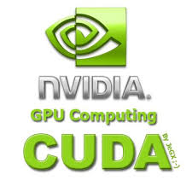
Pnmath
CUDA and OpenCL:
NVIDIA: CUDA
Use compiler to build kernels
C language extensions(nvcc)
  Also a low-level driver-only API
Open-free standard.
Builds kernel at runtime.
API only, no new compiler-API calls to execute kernel
http://www.nvidia.com/object/cuda_home_new.html
https:/www.khronos.org/opencl/
Notes:
API only; no new compiler – API calls to execute kernel
OpenCL is a free standard for cross-platform, parallel programming heterogeneous computing.
It is not only for GPU but for also for other architectures,

Slide 51
Pnmath
Directive based GPU code:
Two main products
  PGI accelerators
  HMPP (CAPS enterprise)
Normal C or Fortran code with directives to guide compiler in creating a GPU version.
Backend supporting CUDA, OpenCL and even normal CPUs.

Slide 52
Pnmath
Directive based GPU code:
Pros
  Same code base as CPU version
  Less time consuming
  Portability is better due to different back-ends support.
Cons
  Generated code may not be as fast as hand-tuned CUDA.

Slide 53
Pnmath
OpenACC:
A collection of compiler directives to specify loops and regions of code in standard C,C++ and Fortran.
Allow programmer to create high-level host+ accelerators programs without the need to explicitly initialize the device, manage data or program transfers.
Backed by PGI, CAPS, Cray and NVIDIA
Part of OpenMP 4.0 ?
More information: http://www.openacc-standard.org/
Notes:
The OpenACC Application Program Interface describes a collection of compiler directives to specify loops and regions of code in standard C, C++ and Fortran to be offloaded from a host CPU to an attached accelerator, providing portability across operating systems, host CPUs and accelerators.
The directives and programming model defined in this document allow programmers to create high-level host+accelerator programs without the need to explicitly initialize the accelerator, manage data or program transfers between the host and accelerator, or initiate accelerator startup and shutdown.
All of these details are implicit in the programming model and are managed by the OpenACC API-enabled compilers and runtimes. The programming model allows the programmer to augment information available to the compilers, including specification of data local to an accelerator, guidance on mapping of loops onto an accelerator, and similar performance-related details.

Slide 54
Pnmath
Ocelot:
Aim to compile CUDA programs to so that they can be run on architectures other than NIVIDA GPUs
It is a modular dynamic compilation framework for heterogeneous system, providing various backend targets for CUDA programs and analysis modules for the PTX virtual instruction set.
Proliferation of Heterogeneous computing.
Ocelot currently allows CUDA programs to be executed on NVIDIA GPUs, AMD GPUs, and x86-CPUs at full speed without recompilation.
Notes:
Ocelot is a modular dynamic compilation framework for heterogeneous system, providing various backend targets for CUDA programs and analysis modules for the PTX virtual instruction set.
Ocelot currently allows CUDA programs to be executed on NVIDIA GPUs, AMD GPUs, and x86-CPUs at full speed without recompilation.

Slide 55
Pnmath
Programming languages and GPGPU:
pyCUDA, pyOpenCL
MATLAB with CUDA toolbox
CUDA FORTRAN
ROpenCL, RCUDA
Haskell, Perl etc…

Slide 56
Pnmath
Resources:
http://developer.nvidia.com/category/zone/cuda-zone
http://gpgpu.org/
http://developer.nvidia.com/about-parallel-forall
http://www.gputechconf.com/page/home.html#
http://software.intel.com/en-us/articles/vcsource-tools-opencl-sdk/
http://developer.amd.com/pages/default.aspx
http://developer.download.nvidia.com/compute/DevZone/docs/html/CUDALibraries/doc/CUBLAS_Library.pdf
http://www.vpac.org/files/GPU-Slides/04.debugging_profiling_tools.pdf
http://keeneland.gatech.edu/software/cuda
http://developer.nvidia.com/nvidia-visual-profiler
Notes:
If you are interested to look for latest update of GPGPU
Parallel Forall is NVIDIA’s GPU Computing developer blog, focused on providing detailed technical information on a variety of programming topics, including CUDA C/C++, OpenACC, GPU-accelerated libraries, GPU programming techniques, and much more.
GPU tech conference coming up : GPU Technology Conference
http://developer.amd.com/pages/default.aspx ➔ OpenCL, APU FUSION development toolkit,
http://developer.download.nvidia.com/compute/DevZone/docs/html/CUDALibraries/doc/CUBLAS_Library.pdf

Slide 57
Pnmath
Rules for fast GPU code:
Get the data on the GPU(and keep it there! If possible)
  PCIe x16 v2.0 bus: 8GiB/s in a single direction
  GPUs: ~180 GiB/s
Give the GPU enough work to do
Reuse and locate data to avoid global memory bottlenecks
Corollary: Avoid malloc/free
Notes:
rules for fast GPU codes
Get the data on the GPU (and keep it there!)
PCIe x16 v2.0 bus: 8 GiB/s in a single direction
20-series GPUs: 140-200 GiB/s
Give the GPU enough work to do
Assume 10 μs latency and 1 TF device
Can waste (10⁻⁶ * 10¹²) = 1M operations
Reuse and locate data to avoid global memory bandwidth bottlenecks
10¹² flop hardware delivers 10¹⁰ flop when global memory limited
Can cause a 100x slowdown!
Corollary: Avoid malloc/free!

Slide 58
Pnmath
Summary:
Accelerated supercomputers are emerging.
GPUs offer tremendous potential to accelerate scientific applications.
Newer generations GPUs getting easier to program.
Challenges still remain in using them efficiently.
Still a few cliffs:
  HOST-GPU transfer
  Careful memory access
  Lots of parallelism
  Thread divergence
Notes:
Divergence
– Threads in a warp take different execution paths
Reason: Control Flows in Code
– E.g., if, do, for, while, switch
• Input Data Dependence
– Input data-set --> execution path
– Thread-data mapping --> amount of thread divergence
Effect: It Degradis GPU Throughput

Slide 59
Pnmath
Accelerated Supercomputer:
Challenges remain
  Applicability: Can you solve your algorithm efficiently using a GPU ?
  Programmability: Effort of code writing that uses a GPU efficiently.
  Portability: Incompatibilities between vendors
  Availability: Are you able gain access to large scale system ?
  Scalability: Can you scale the GPU software efficiently to several nodes ?

Slide 60
Pnmath
References:
https://nimrodteam.org/meetings/team_mtg_8_10/nimrod_gpu.pdf
http://people.maths.ox.ac.uk/~gilesm/hpc/NVIDIA/NVIDIA_CUDA_Tutorial_No_NDA_Apr08.pdf
http://www.nvidia.com/docs/IO/105880/DS-Tesla-M-Class-Aug11.pdf
http://www.nics.tennessee.edu/~ksharkey/tutorials/
http://en.wikipedia.org/wiki/Graphics_processing_unit
http://www.cc.gatech.edu/~vetter/keeneland/tutorial-2012-02-20/08-opencl.pdf
http://developer.amd.com/gpu_assets/OpenCL_Parallel_Computing_for_CPUs_and_GPUs_201003.pdf
http://gamelab.epitech.eu/blogtech/?p=28
Introduction GPU computing by Sebastian von alfthan
Supercomputing for the Masses: Killer-Apps, Parallel Mappings, Scalability and Application Lifespan by Rob Farber
The PTX GPU Assembly Simulator and Interpreter By N.M. Stiffler, Zheming Jin, Ibrahim Savran

Slide 61
Pnmath
Summary/Wrapping up:
In this tutorial session, we covered
  GPU architecture
  GPU programming model
  CUDA C
  CUDA tools
  Other useful GPU tools
  References

Slide 62
Pnmath
Thank You for attending NICS HPC Seminar Series !!!
Notes:
Thank you very much for attending NICS-RDAV training. If you have any question, Please ask me or you can email me at pragnesh@utk.edu

Slide 63
Pnmath
Jacket:
It combines the speed of CUDA and the graphics of the GPU with the user friendliness.
Provides GPU library for C, C++, Fortran, Python and MATLAB.
Provides GPU counterparts to CPU data types, such as real and complex double, single,uint32, int32, logical, etc. Any variable residing in the host (CPU) memory can be cast to Jacket's GPU data types.
It’s memory management system allocates and manages memory for these variables on the GPU automatically, behind-the-scenes. Any functions called on GPU data will execute on the GPU automatically without any extra programming.
For more information: http://www.accelereyes.com/
Notes:
Here I am talking about MATLAB
Jacket's memory management system allocates and manages memory for these variables on the GPU automatically, behind-the-scenes. Any functions called on GPU data will execute on the GPU automatically without any extra programming.
addpath <jacket_root>/engine
X = gdouble( magic( 3 ) );
Y = gones( 3, 'double' );
A = X * Y

Slide 64
Pnmath
Jacket example:
CPU:
X = double( magic( 3 ) );
Y = ones( 3, 'double' );
A = X * Y
GPU:
addpath <jacket_root>/engine
X = gdouble( magic( 3 ) );
Y = gones( 3, 'double' );
A = X * Y
Notes:
Note that the only difference between this code and CPU-based MATLAB code is the introduction of the GDOUBLE casting functions and GONES. GONES is equivalent to the MATLAB ONES function but creates the matrix on the GPU.
Suppose you want to bring matrix A on CPU to do some CPU processing. We can use standard MATLAB casting "double(A)" to copy it on CPU memory.

